Slide 1
Microsoft Word 2010
Chapter 1
Creating, Formatting, and Editing a Word Document with Pictures

Slide 2
Objectives
Enter text in a Word document
Check spelling as you type
Format paragraphs
Format text
Undo and redo commands or actions
Change theme colors

Slide 3
Objectives
Insert digital pictures in a Word document
Format pictures
Add a page border
Correct errors and revise a document
Change document properties
Print a document

Slide 4

Project – Flyer with Pictures

Slide 5
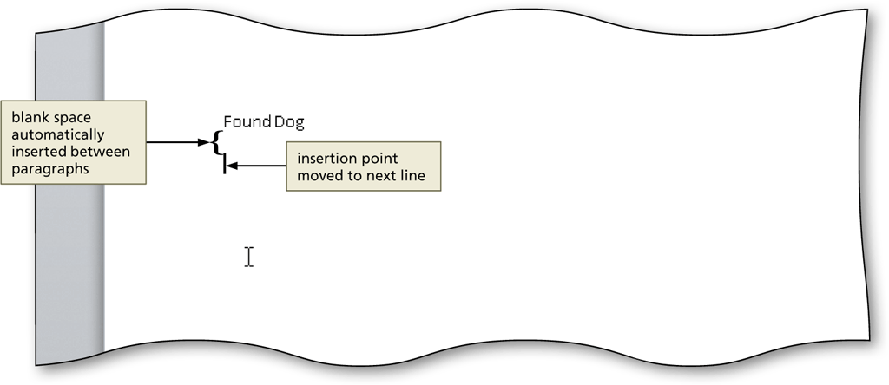
Entering Text
Type the text in the Word document
To move the insertion point to the beginning of the next line, press the ENTER key

Slide 6
Displaying Formatting Marks
If the Home tab is not the active tab, click Home on the Ribbon to display the Home tab.
If it is not selected already, click the Show/Hide ¶ button (Home tab | Paragraph group) to display formatting marks on the screen

Slide 7
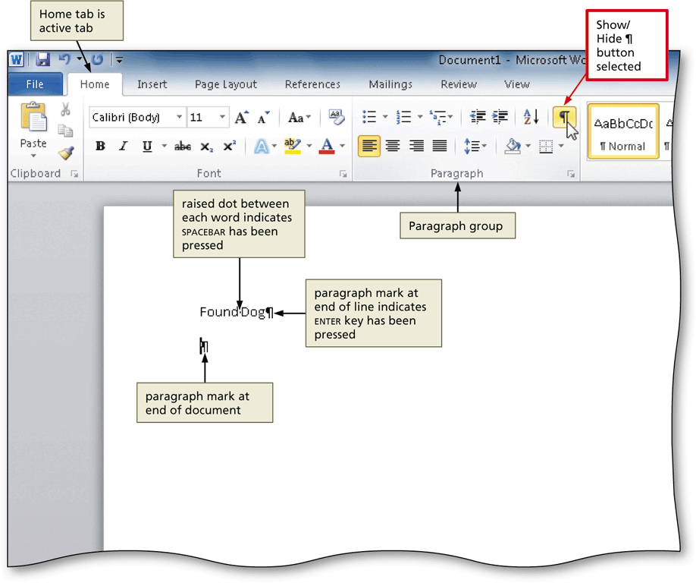
Displaying Formatting Marks

Slide 8
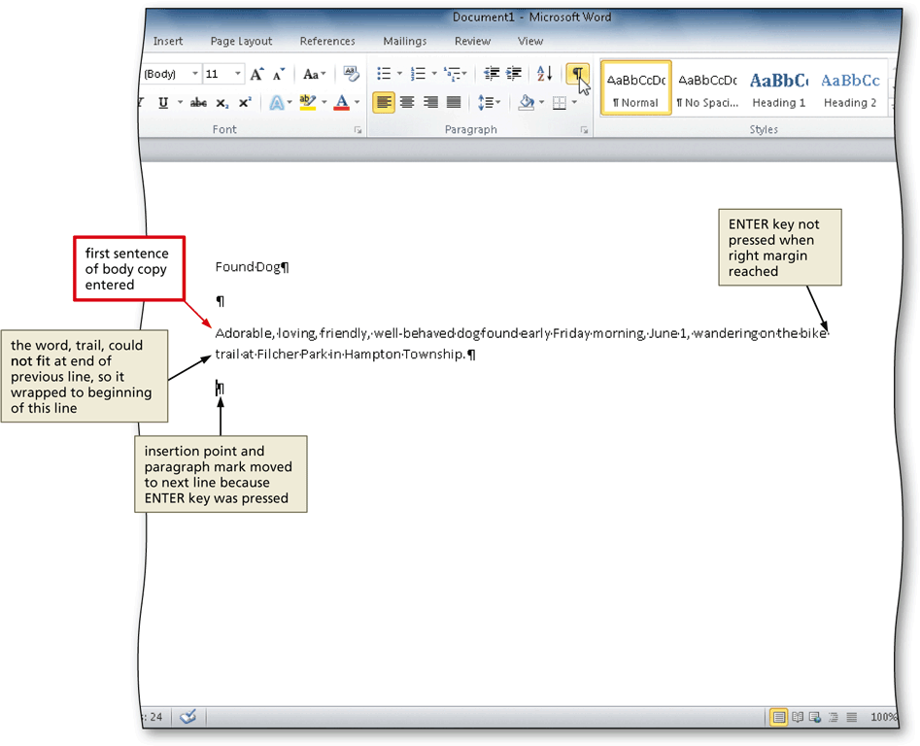
Wordwrap
Wordwrap allows you to type words in a paragraph continually without pressing the ENTER key at the end of each line

Slide 9
Checking Spelling and Grammar as You Type
Type the misspelled text and then press the SPACEBAR so that a red wavy line appears below the misspelled word
Right-click the flagged word to display a shortcut menu that presents a list of suggested spelling corrections for the flagged word
Click the correct word on the shortcut menu

Slide 10
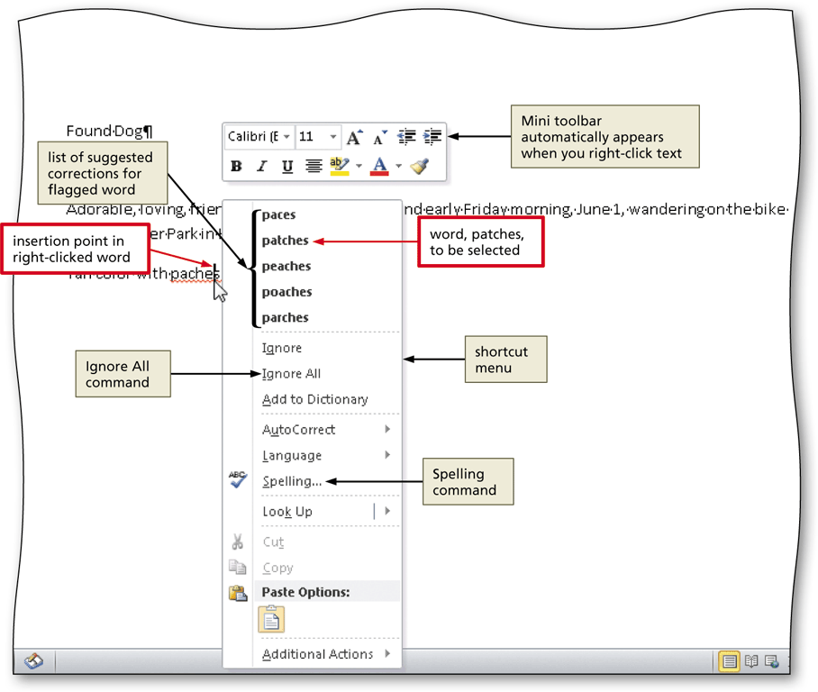
Checking Spelling and Grammar as You Type

Slide 11
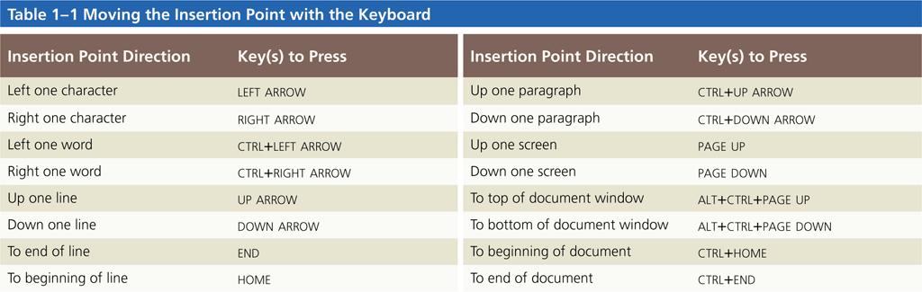
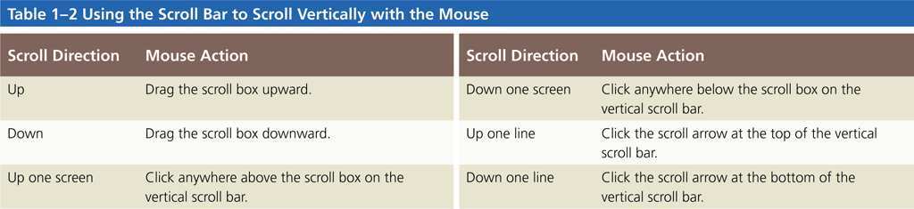
Navigating a Document

Slide 12
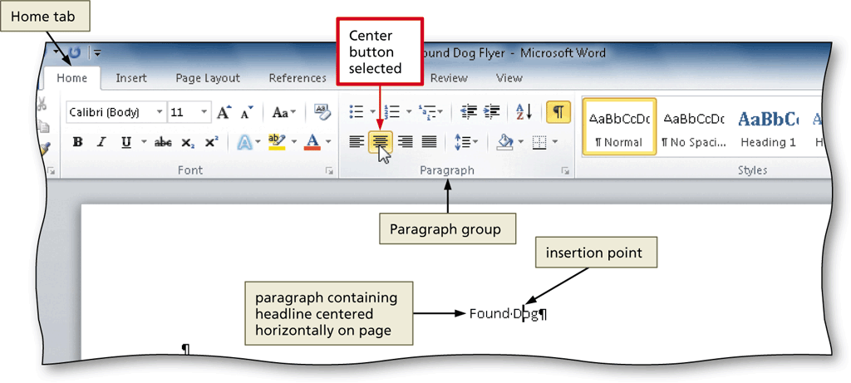
Centering a Paragraph
Click somewhere in the paragraph to be centered to position the insertion point in the paragraph to be formatted
Click the Center button (Home tab | Paragraph group) to center the paragraph containing the insertion point

Slide 13
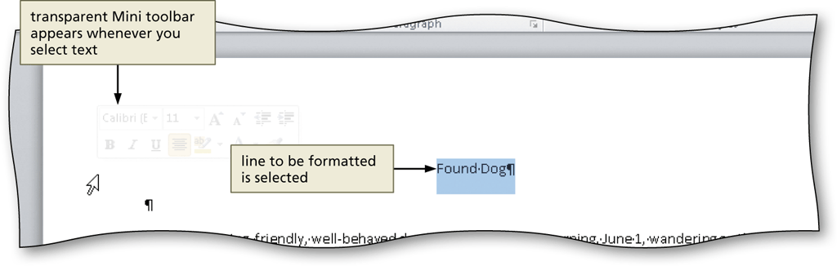
Selecting a Line
Move the mouse pointer to the left of the line to be selected until the mouse pointer changes to a right-pointing block arrow
Click the mouse to select the entire line to the right of the mouse pointer

Slide 14
Changing the Font Size of Selected Text
With the text selected, click the Font Size box arrow (Home tab | Font group) to display the Font Size gallery
Point to the desired point size in the Font Size gallery to display a live preview of the selected text at the selected point size
Click the desired point size to change the font size of the selected text

Slide 15
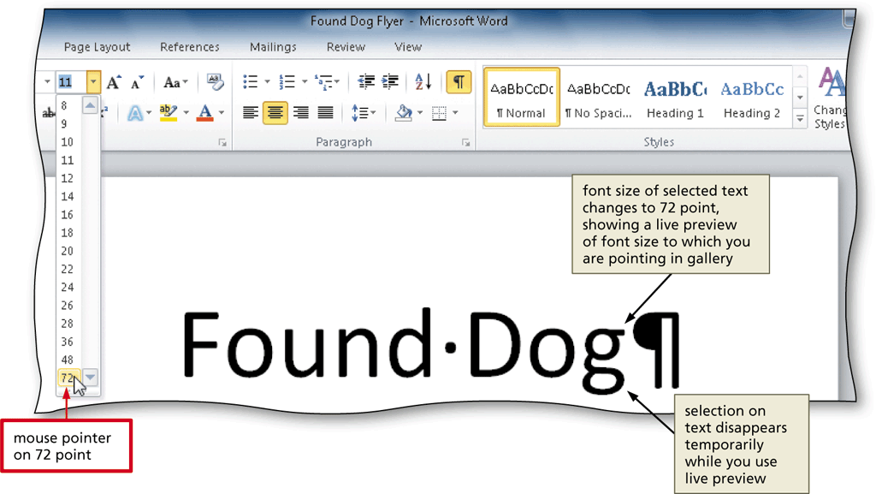
Changing the Font Size of Selected Text

Slide 16
Changing the Font of Selected Text
With the text selected, click the Font box arrow (Home tab | Font group) to display the Font gallery
Scroll through the Font gallery, and then point to the desired font to display a live preview of the selected text in the selected font
Click the font to change the font of the selected text

Slide 17
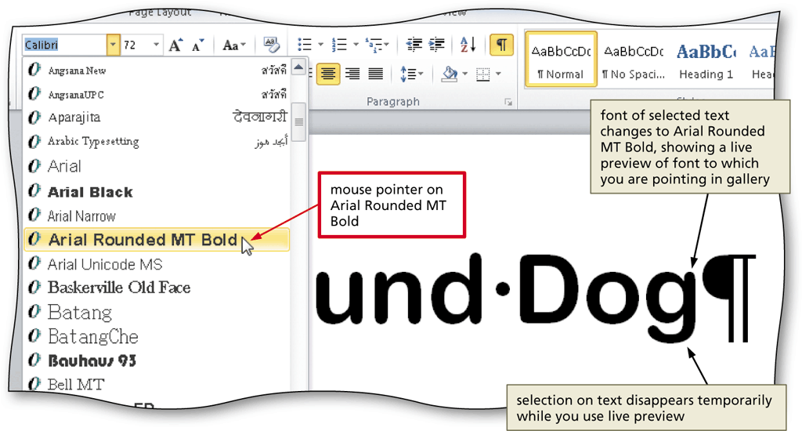
Changing the Font of Selected Text

Slide 18
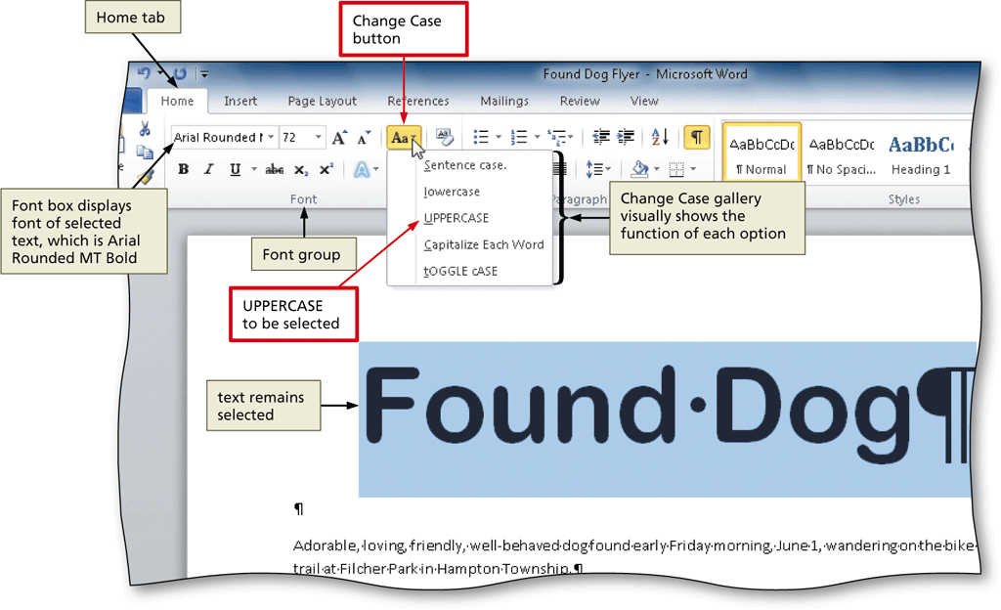
Changing the Case of Selected Text
With the text selected, click the Change Case button (Home tab | Font group) to display the Change Case gallery
Click the desired case in the Change Case gallery to change the case of the selected text

Slide 19
Applying a Text Effect to Selected Text
With the text selected, click the Text Effects button (Home tab | Font group) to display the Text Effects gallery
Point to the desired text effect to display a live preview of the selected text in the selected text effect
Click the text effect to change the text effect of the selected text

Slide 20
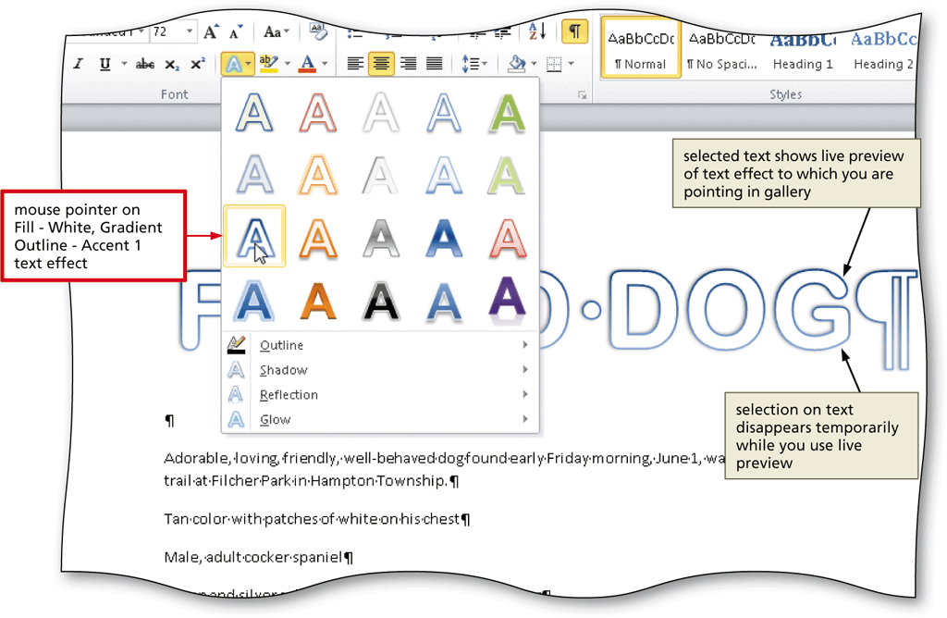
Applying a Text Effect to Selected Text

Slide 21
Shading a Paragraph
Click somewhere in the paragraph to be shaded
Click the Shading button arrow (Home tab | Paragraph group) to display the Shading gallery
Point to the desired shading to display a live preview of the selected shading color
Click the shading color

Slide 22
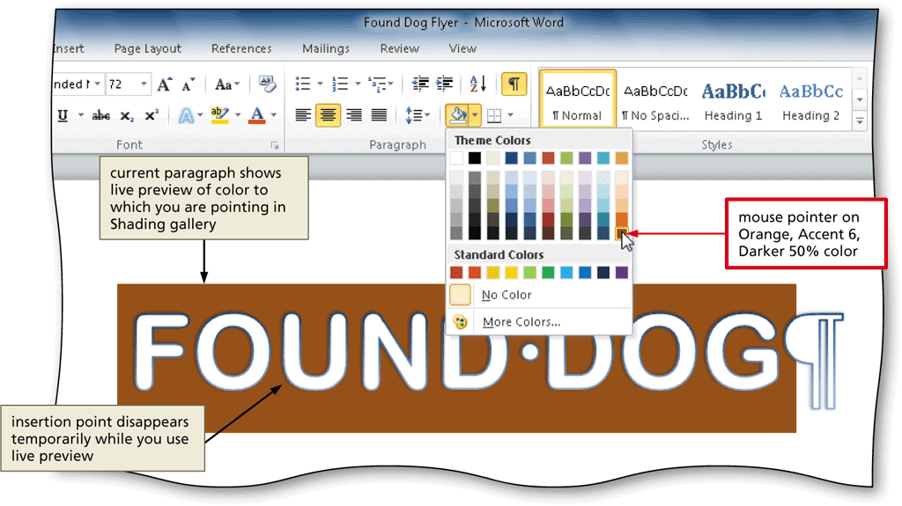
Shading a Paragraph

Slide 23
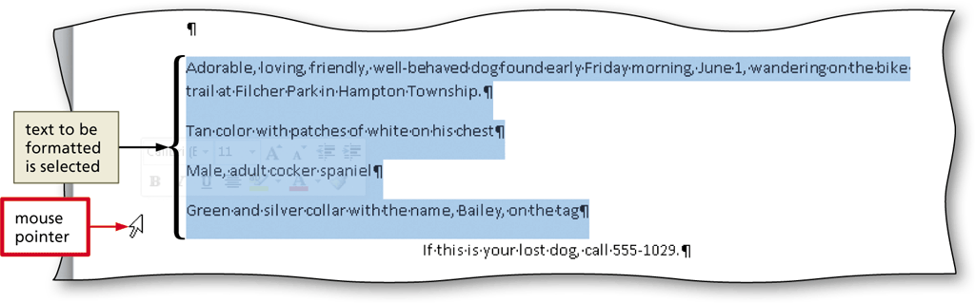
Selecting Multiple Lines
Move the mouse pointer to the left of the first paragraph to be selected until the mouse pointer changes to a right-pointing block arrow
Drag downward to select all lines that will be formatted

Slide 24
Bulleting a List of Paragraphs
Move the mouse pointer to the left of the first paragraph to be selected until the mouse pointer changes to a right-pointing block arrow
Drag downward until all paragraphs that will be formatted with a bullet character are selected
Click the Bullets button (Home tab | Paragraph group) to place a bullet character at the beginning of each selected paragraph

Slide 25
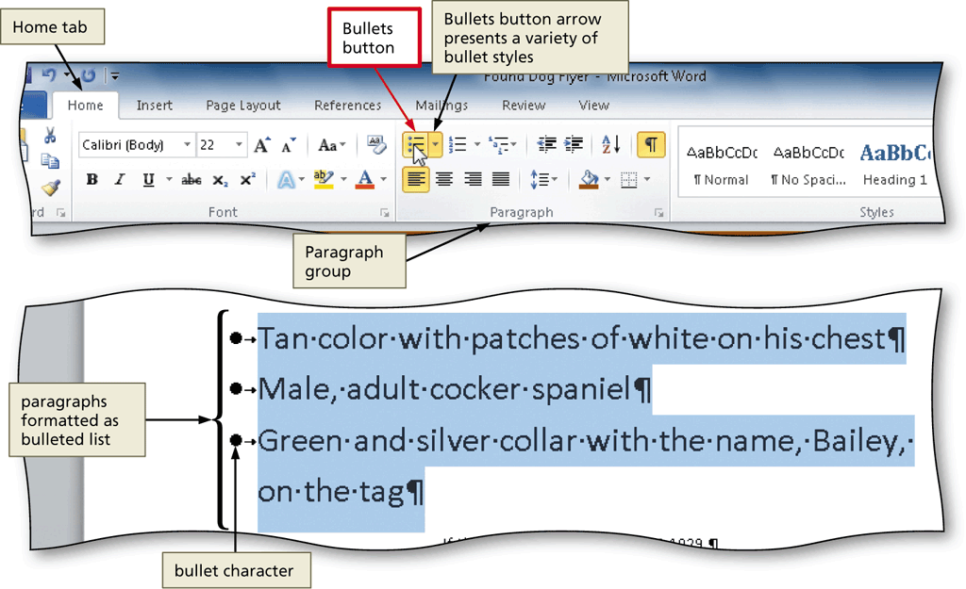
Bulleting a List of Paragraphs

Slide 26
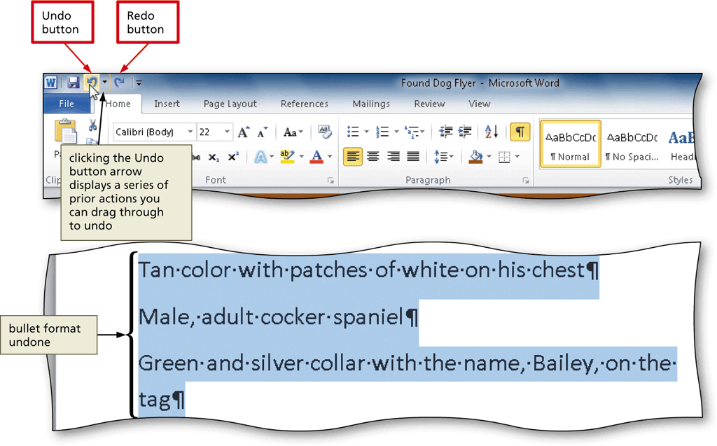
Undoing and Redoing an Action
Click the Undo button on the Quick Access Toolbar to reverse your most recent action
Click the Redo button on the Quick Access Toolbar to reverse your most recent undo

Slide 27
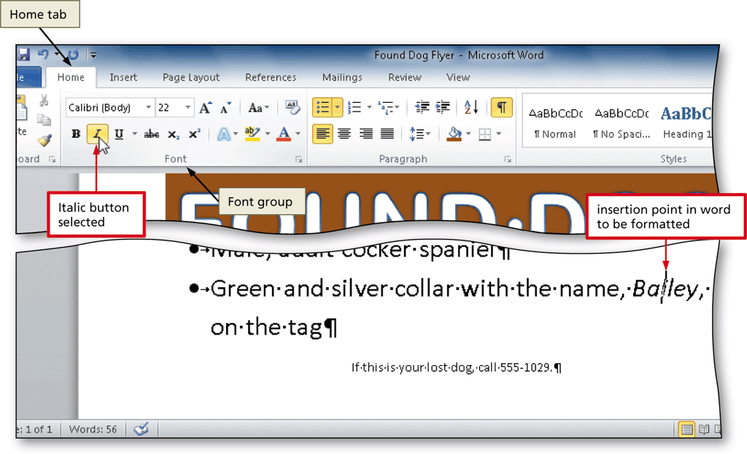
Italicizing Text
Click somewhere in the word to be italicized to position the insertion point in the word to be formatted
Click the Italic button (Home tab | Font group) to italicize the word containing the insertion point

Slide 28
Coloring Text
With the insertion point in the word to format, click the Font Color button arrow (Home tab | Font group) to display the Font Color gallery
Point to the desired font color to display a live preview of the desired font color
Click the font color to change the color of the text

Slide 29
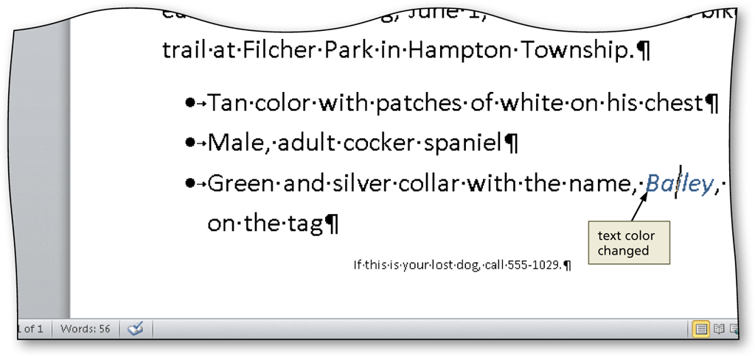
Coloring Text

Slide 30
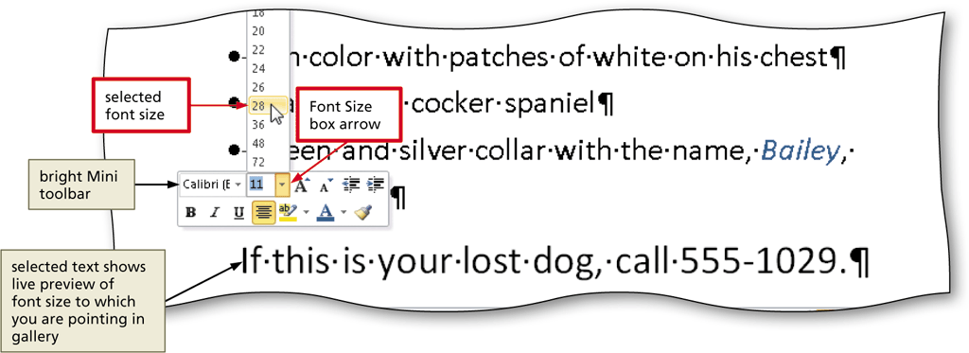
Using the Mini Toolbar to Format Text
Select the text to format, and then move the mouse pointer into the transparent Mini toolbar, so that it changes to a bright toolbar

Slide 31
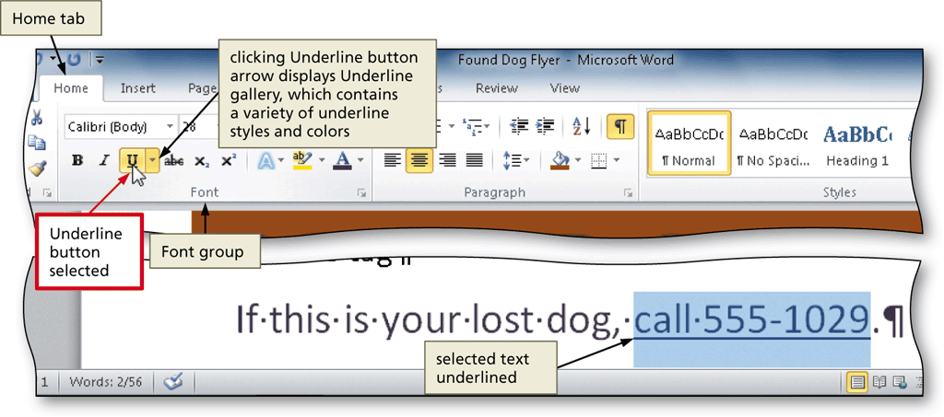
Underlining Text
With the text selected, click the Underline button (Home tab | Font group) to underline the selected text

Slide 32
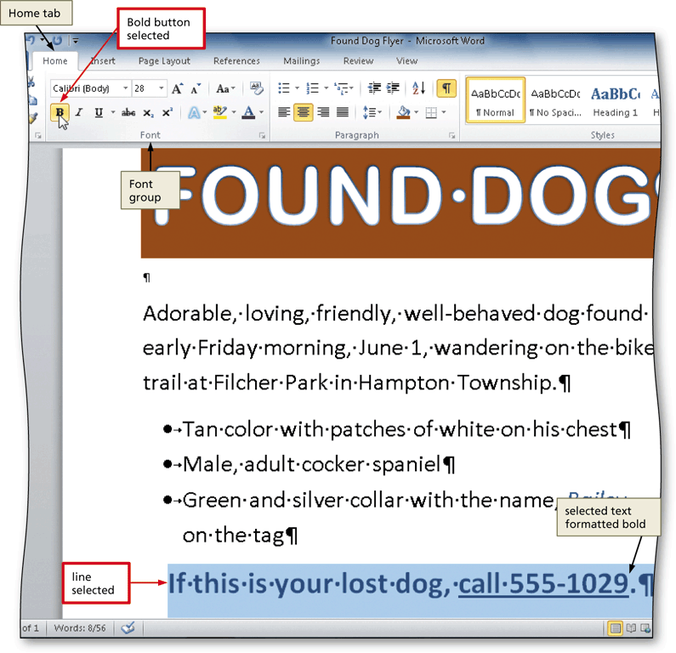
Bolding Text
With the text selected, click the Bold button (Home tab | Font group) to bold the selected text

Slide 33
Changing Theme Colors
Click the Change Styles button (Home tab | Styles group) to display the Change Styles menu
Point to Colors on the Change Styles menu to display the Colors gallery
Click the desired theme color to change the document theme colors

Slide 34

Changing Theme Colors

Slide 35
Inserting a Picture
Position the insertion point where you want to insert the picture
Click Insert on the Ribbon to display the Insert tab
Navigate to the picture location
Select the picture you wish to insert
Click the Insert button (Insert Picture dialog box) to insert the picture at the location of the insertion point in the document

Slide 36
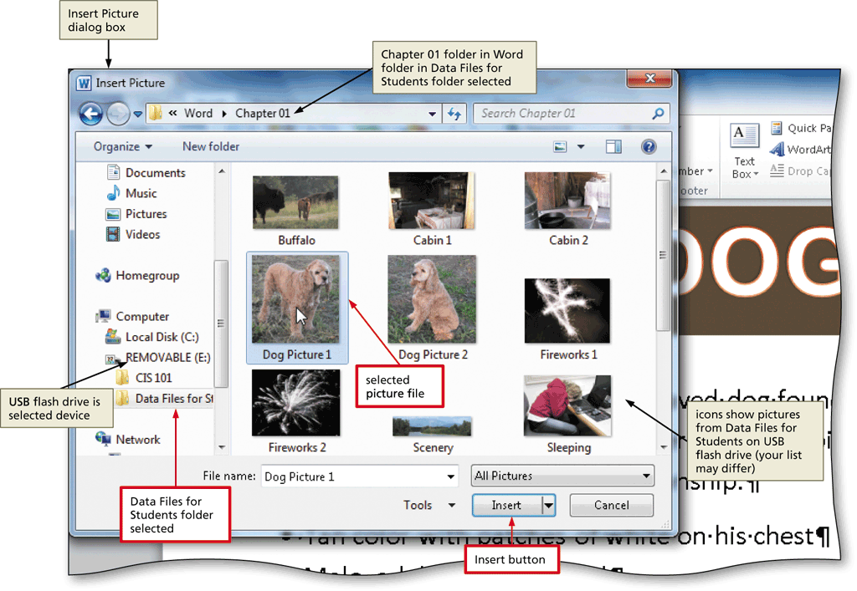
Inserting a Picture

Slide 37
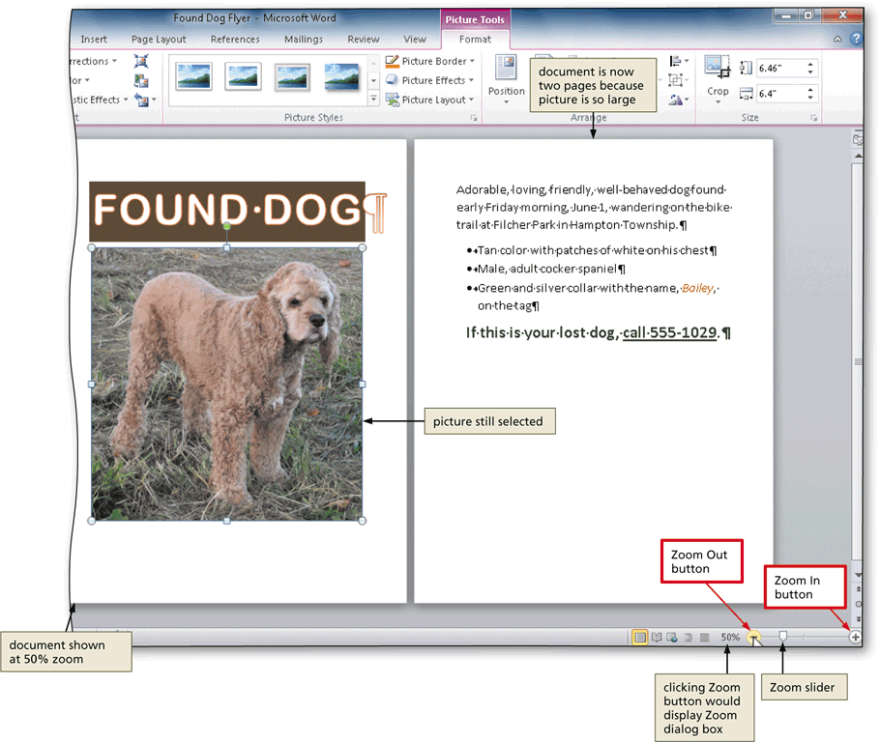
Zooming the Document
Click the Zoom Out or Zoom In button as many times as necessary

Slide 38
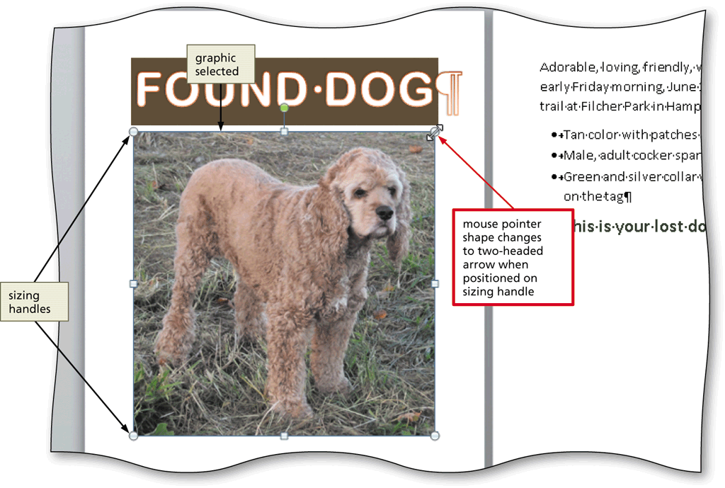
Resizing a Graphic
Drag one of the sizing handles to increase or decrease the size of the graphic

Slide 39
Resizing a Graphic by Entering Exact Measurements
With the graphic selected, click the Shape Height box (Picture Tools Format tab | Size group) to select the contents in the box and then type the desired height
Click the Shape Width box to select the contents in the box, type the desired width, and then click the picture to apply the settings

Slide 40
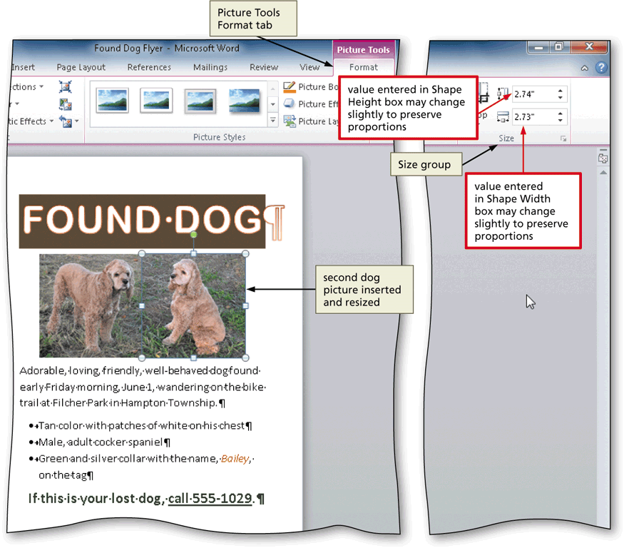
Resizing a Graphic by Entering Exact Measurements

Slide 41
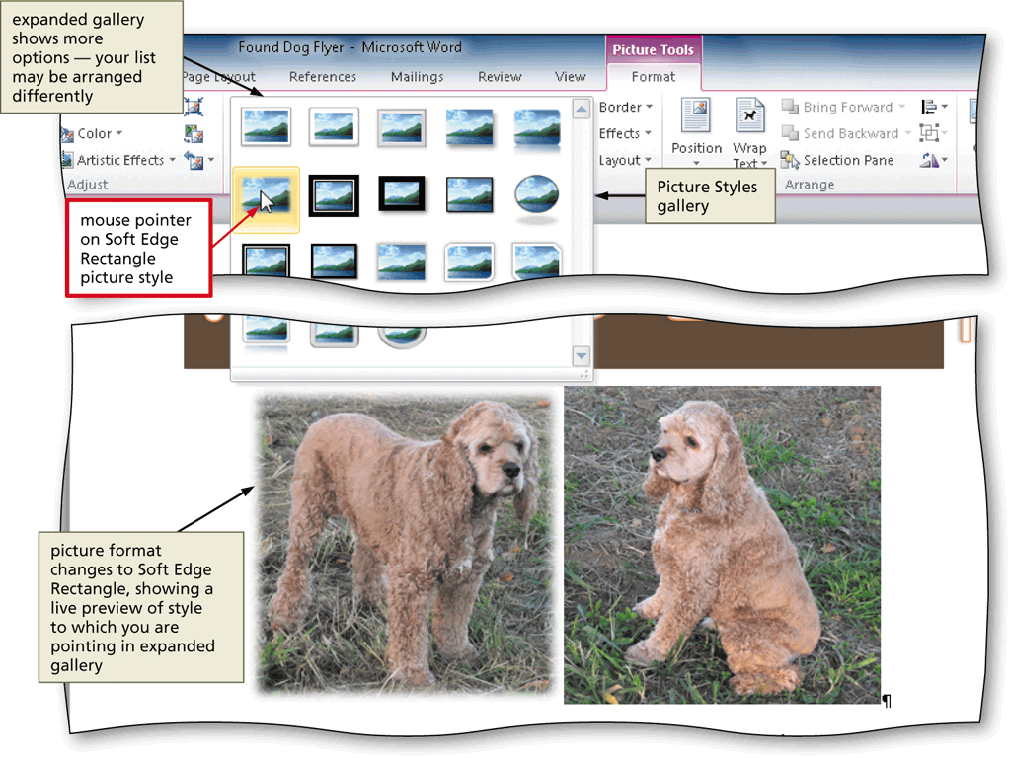
Applying a Picture Style
With the picture selected, click the desired picture style in the Picture Styles gallery (Picture Tools Format tab | Picture Styles group). Click the More button to display additional picture styles

Slide 42
Applying Picture Effects
Click the Picture Effects button (Picture Tools Format tab | Picture Styles group) to display the Picture Effects menu
Point to the desired picture effect type
Click the desired picture effect in the gallery to apply the selected picture effect

Slide 43
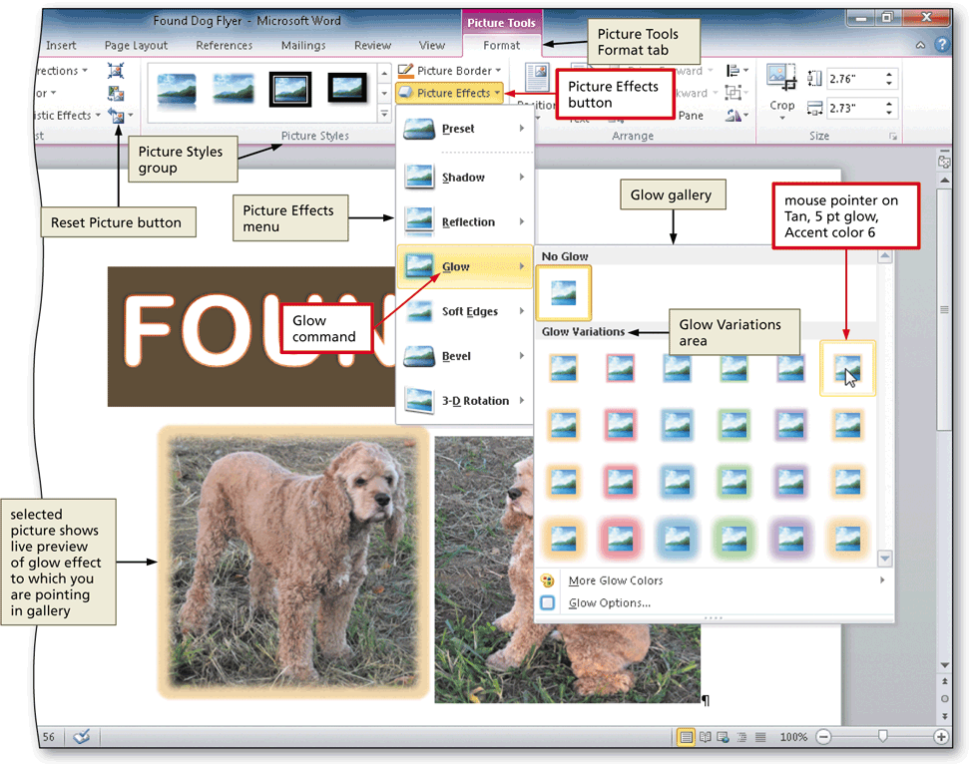
Applying Picture Effects

Slide 44
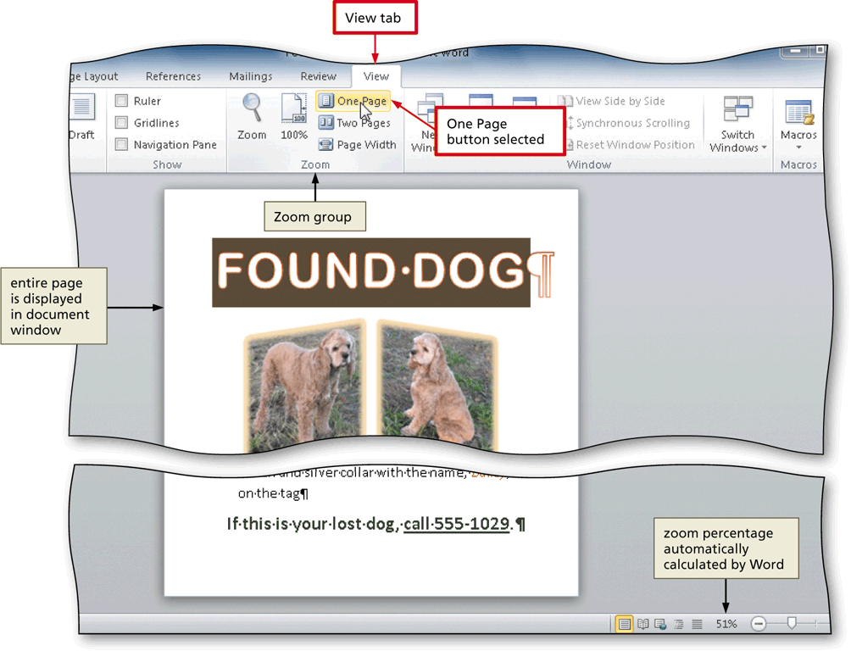
Viewing One Page
Click View on the Ribbon to display the View tab
Click the One Page button (View tab | Zoom group) to display the entire page in the document window as large as possible

Slide 45
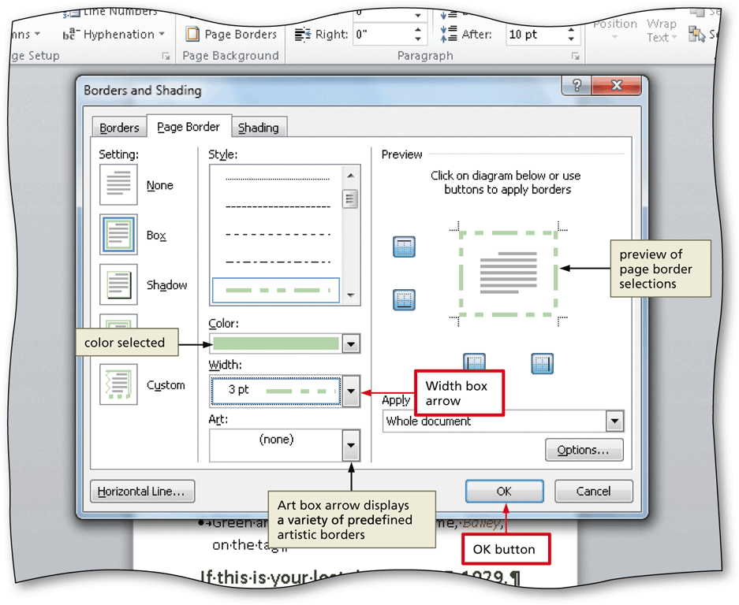
Adding a Page Border
Click Page Layout on the Ribbon to display the Page Layout tab
Click the Page Borders button (Page Layout tab | Page Background group) to display the Borders and Shading dialog box

Slide 46
Changing Spacing Before and After a Paragraph
Click Page Layout on the Ribbon to display the Page Layout tab
Position the insertion point in the paragraph to be adjusted
Change the values in the Spacing Before and Spacing After boxes

Slide 47
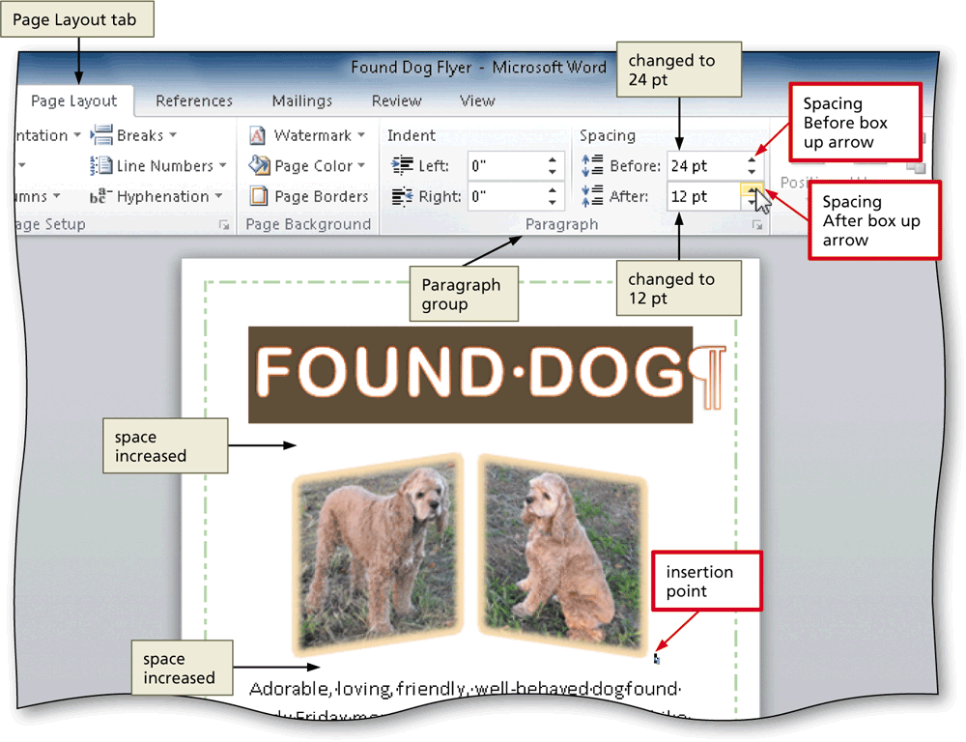
Changing Spacing Before and After a Paragraph

Slide 48
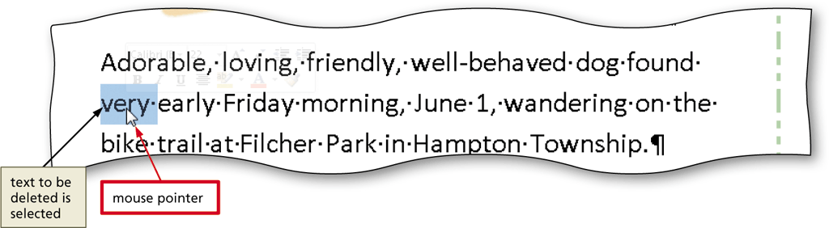
Deleting Text
Select the text to be deleted
With the text selected, press the DELETE key to delete the selected text

Slide 49
Moving Text
Select the text to be moved
With the mouse pointer in the selected text, press and hold down the mouse button, which displays a dotted insertion point and a small dotted box with the mouse pointer
Drag the dotted insertion point to the location where the selected text is to be moved
Release the mouse button to move the selected text to the location of the dotted insertion point

Slide 50
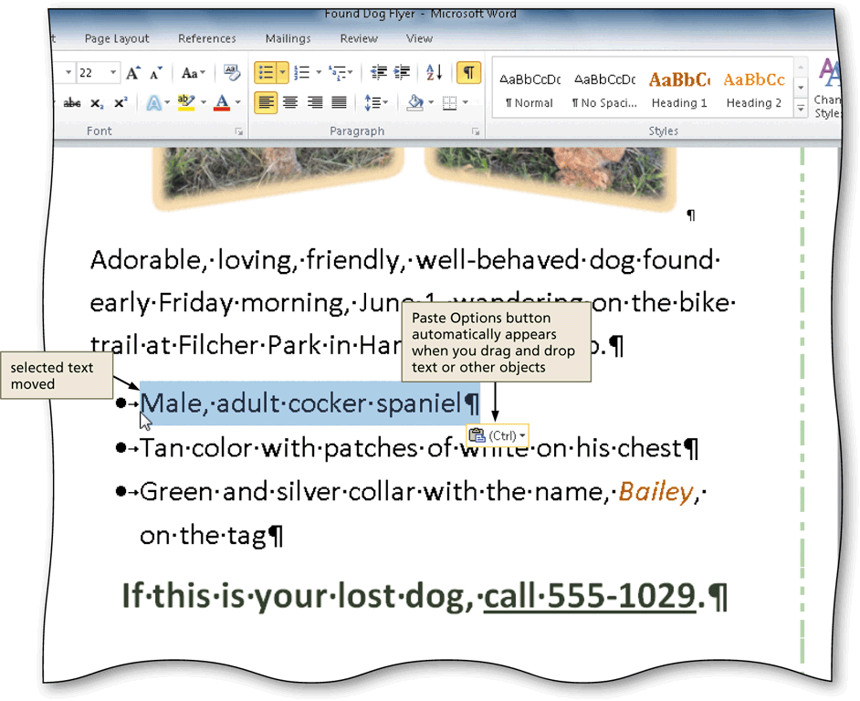
Moving Text

Slide 51
Changing Document Properties
Click File on the Ribbon to open the Backstage view
If necessary, click the Info tab to display the Info gallery
Click the Properties button in the right pane of the Info gallery to display the Properties menu
Click Show Document Panel on the Properties menu to close the Backstage view and display the Document Information Panel in the Word document window

Slide 52
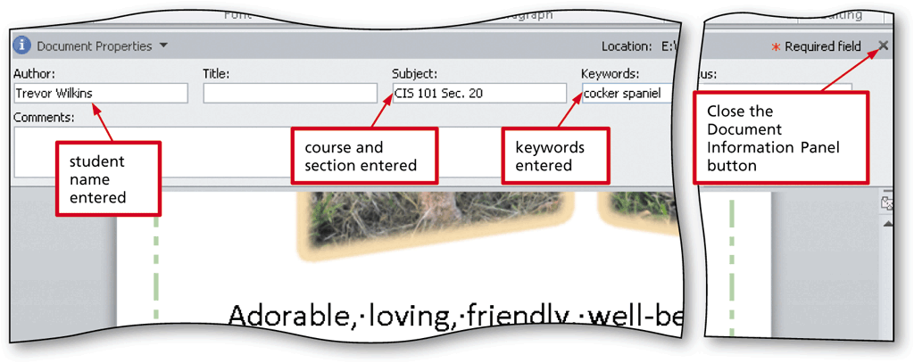
Changing Document Properties
Type the properties in the respective text boxes
Click the Close the Document Information Panel button so that the Document Information Panel no longer is displayed

Slide 53
Printing a Document
Click File on the Ribbon to open the Backstage view
Click the Print tab in the Backstage view to display the Print gallery
Verify the printer name that appears on the Printer Status button will print a hard copy of the document. If necessary, click the Printer Status button to display a list of available printer options and then click the desired printer to change the currently selected printer

Slide 54
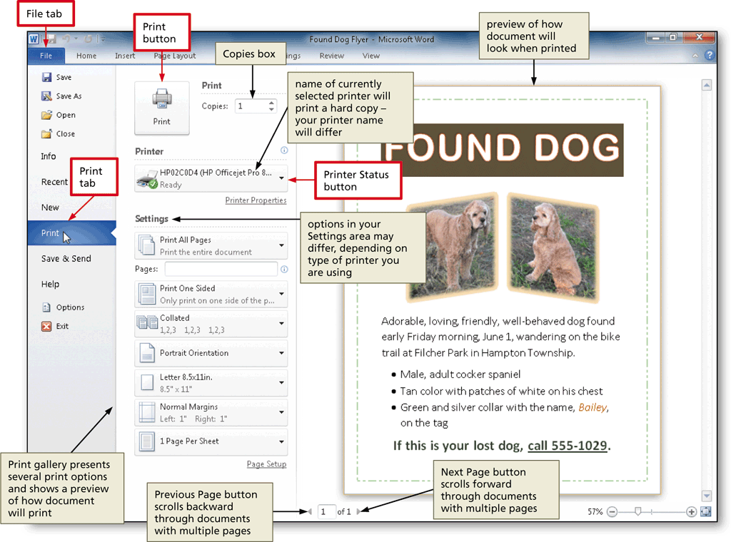
Printing a Document

Slide 55
Microsoft Word 2010
Chapter 2
Creating a Research Paper with Citations and References

Slide 56
Objectives
Describe the MLA documentation style for research papers
Change line and paragraph spacing in a document
Modify a style
Use a header to number pages of a document
Apply formatting using shortcut keys
Modify paragraph indentation
Insert and edit citations and their sources

Slide 57
Objectives
Add a footnote to a document
Insert a manual page break
Create a bibliographical list of sources
Cut, copy, and paste text
Find text and replace text
Find a synonym
Use the Research task pane to look up information

Slide 58
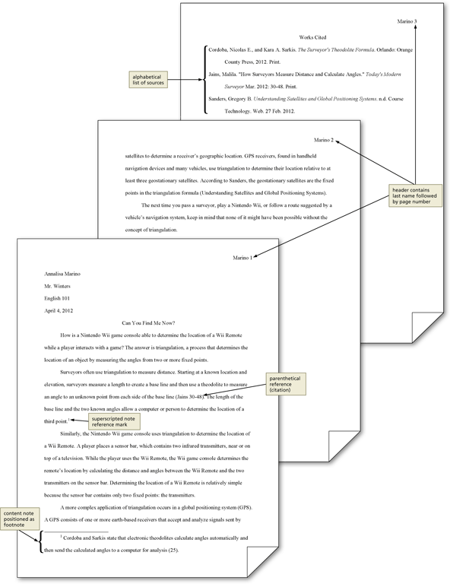
Research Paper

Slide 59
Modifying a Style
Right-click the style to modify in the Quick Style gallery (Home tab | Styles group) to display a shortcut menu related to styles
Click Modify on the shortcut menu to display the Modify Style dialog box
Make the desired changes to the style in the Modify Style dialog box, and then click the OK button to update the style

Slide 60
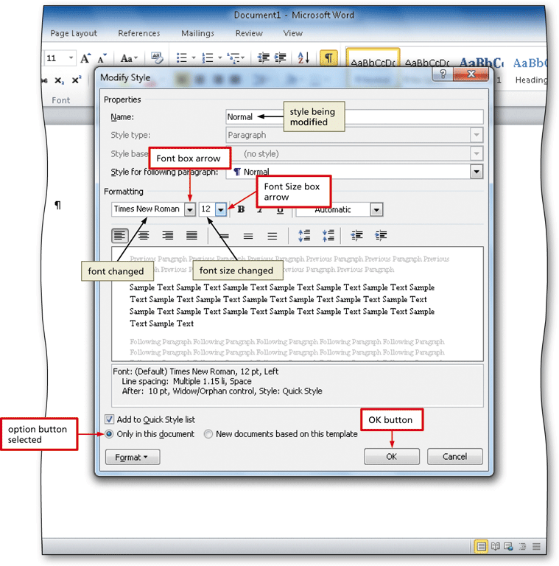
Modifying a Style

Slide 61
Changing Line Spacing
Click the Line and Paragraph Spacing button (Home tab | Paragraph group) to display the Line and Paragraph Spacing gallery
Click the desired setting in the Line and Paragraph Spacing gallery to change the line spacing at the location of the insertion point

Slide 62
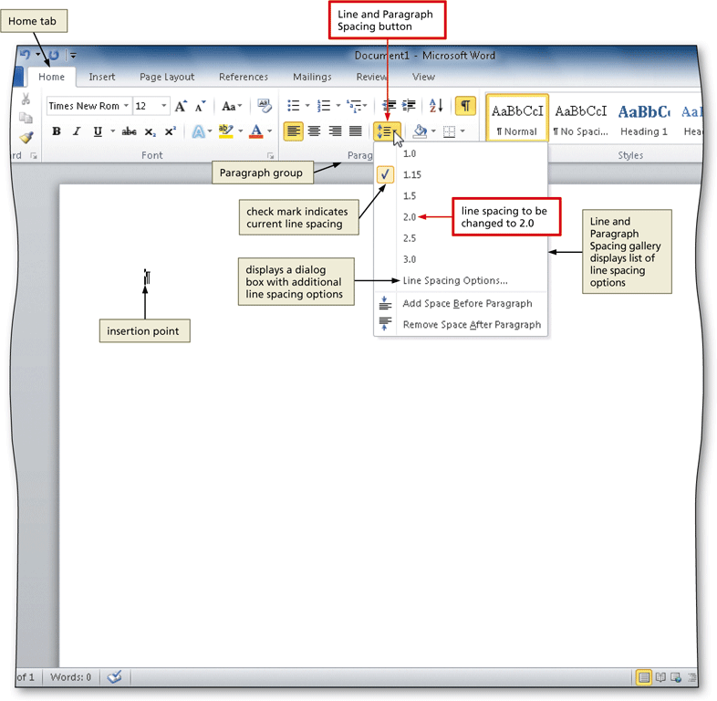
Changing Line Spacing

Slide 63
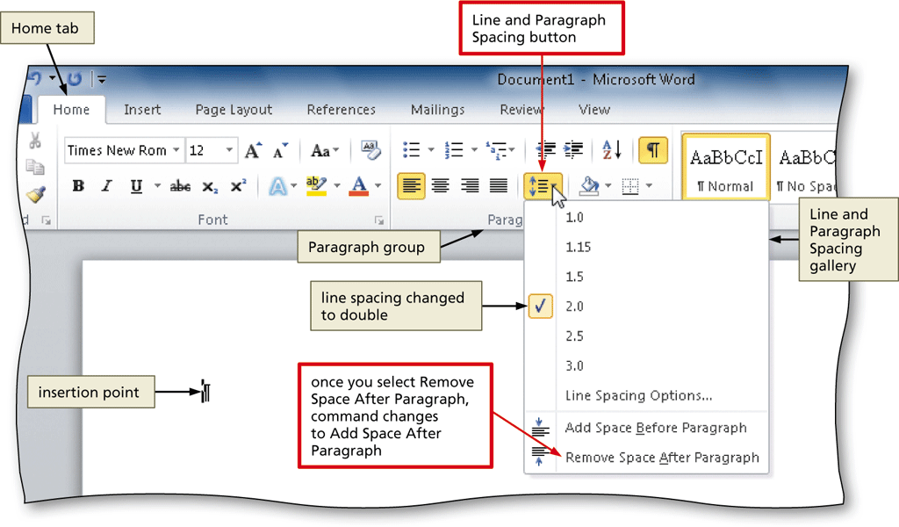
Removing Space after a Paragraph
Click the Line and Paragraph Spacing button (Home tab | Paragraph group) to display the Line and Paragraph Spacing gallery
Click Remove Space After Paragraph in the Line and Paragraph Spacing gallery so that no blank space appears after paragraphs

Slide 64
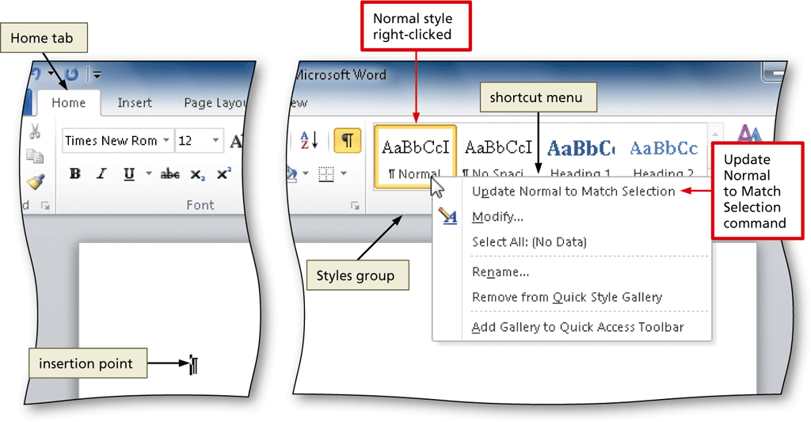
Updating a Style to Match a Selection
Right-click Normal in the Quick Style gallery (Home tab | Styles group) to display a shortcut menu
Click Update Normal to Match Selection on the shortcut menu to update the selected (or current) style to reflect the settings at the location of the insertion point

Slide 65
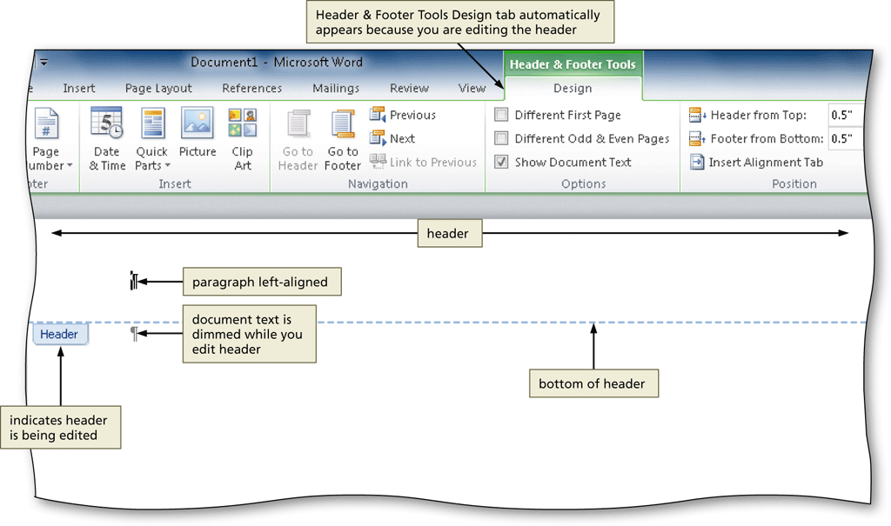
Switching to the Header
Click Insert on the Ribbon to display the Insert tab
Click the Header button (Insert tab | Header & Footer group) to display the Header gallery
Click Edit Header in the Header gallery to switch from the document text to the header, which allows you to edit the contents of the header

Slide 66
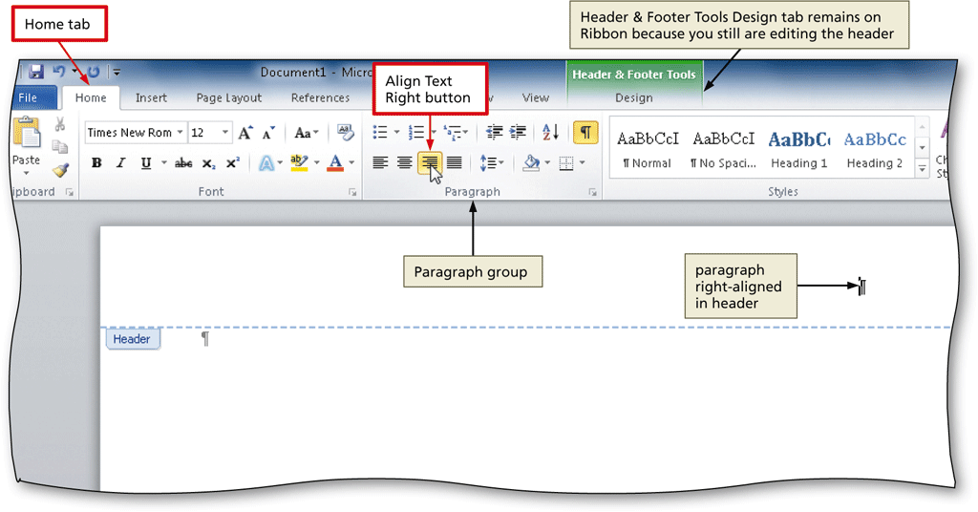
Right-Aligning a Paragraph
Click Home on the Ribbon to display the Home tab
Click the Align Text Right button (Home tab | Paragraph group) to right-align the current paragraph

Slide 67
Inserting a Page Number
Click the Insert Page Number button (Header & Footer Tools Design tab | Header & Footer group) to display the Insert Page Number
Point to the position at which you want to insert the page number, and then select the desired style in the gallery

Slide 68
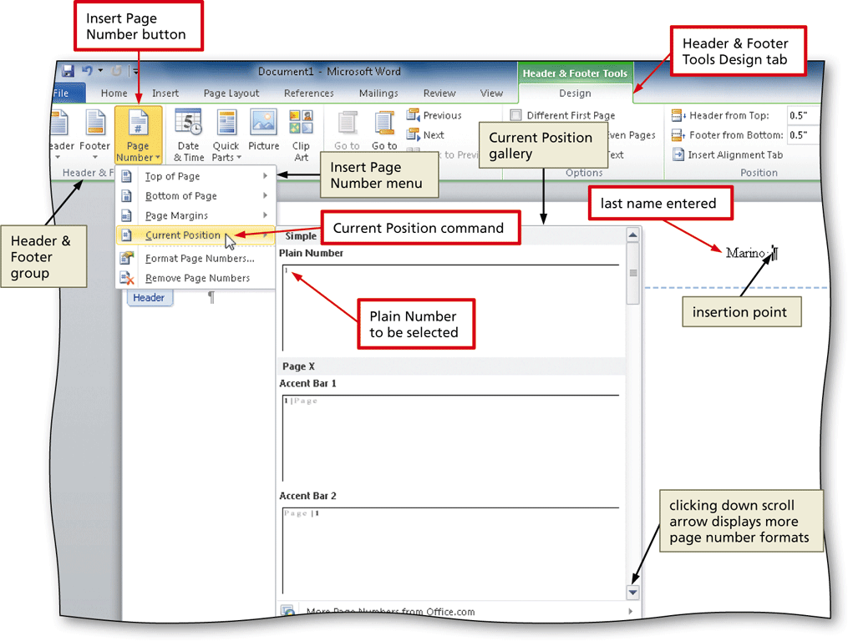
Inserting a Page Number

Slide 69
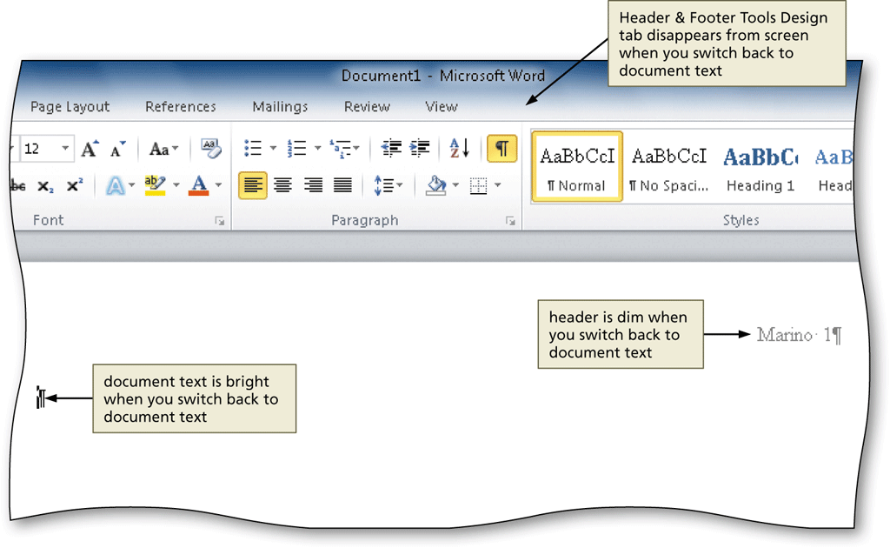
Closing the Header
Click the Close Header and Footer button (Header & Footer Tools Design tab | Close group) to close the header and switch back to the document text

Slide 70
Click and Type
Position the mouse pointer in the location where you want to type, in the center of the document window until a center icon appears below the I-beam
Double-click to center the paragraph and mark the insertion point between the left and right margins
Type the desired text and then press the ENTER key to position the insertion point on the next line

Slide 71
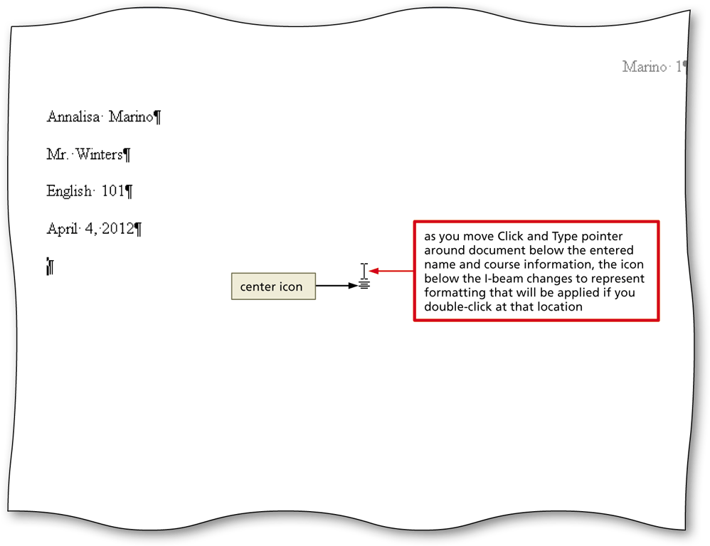
Click and Type

Slide 72
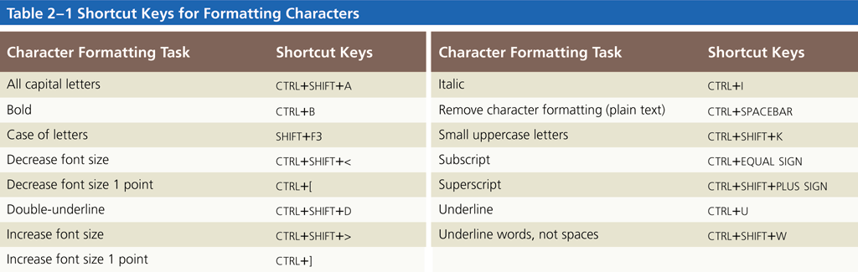
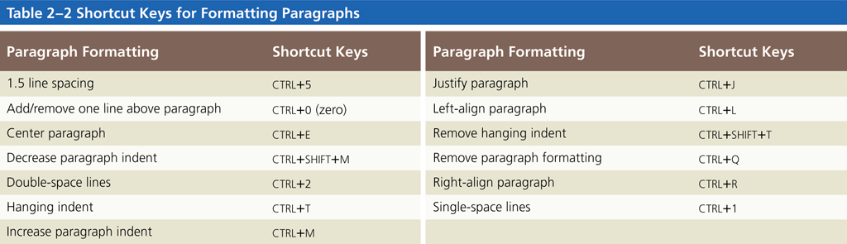
Shortcut Keys

Slide 73
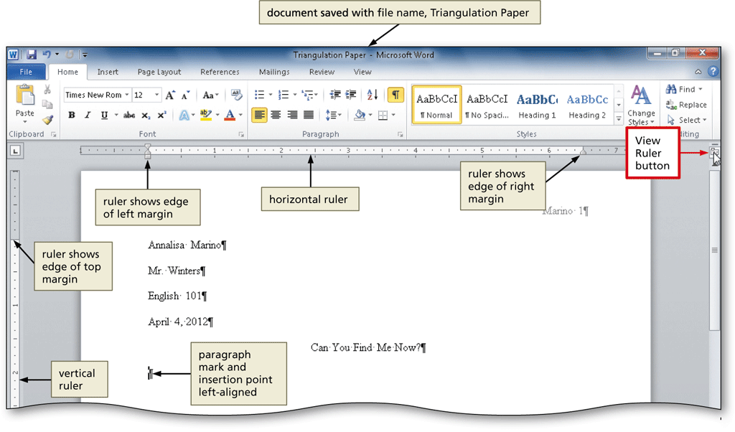
Displaying the Rulers
If the rulers are not displayed, click the View Ruler button on the vertical scroll bar to display the horizontal and vertical rulers on the screen

Slide 74
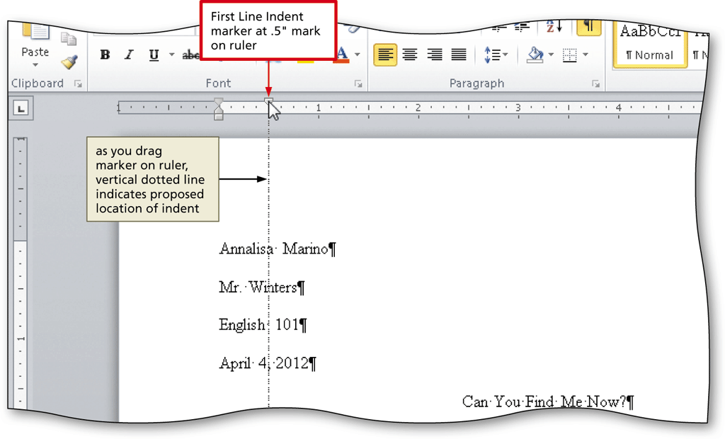
First-Line Indenting Paragraphs
With the insertion point in the paragraph to be indented, drag the First Line Indent marker to the desired location on the ruler to set the location for the first-line indent

Slide 75
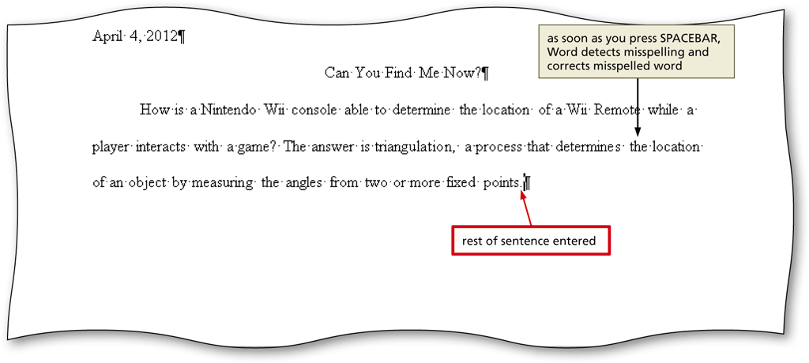
Autocorrecting as You Type
Word provides an AutoCorrect feature that automatically corrects certain typing, spelling, capitalization, or grammar errors as you type a document

Slide 76
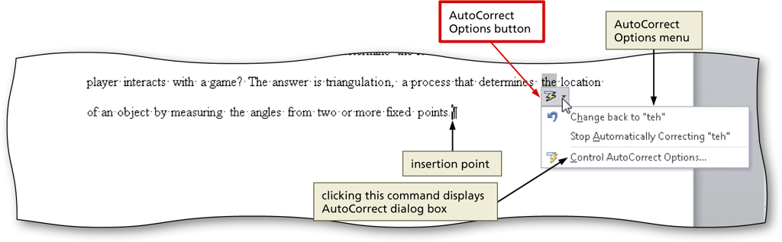
Using the AutoCorrect Options Button
Position the mouse pointer in the text automatically corrected by Word to display a small blue box below the automatically corrected word
Point to the small blue box to display the AutoCorrect Options button
Click the AutoCorrect Options button to display the AutoCorrect Options menu
Press the ESCAPE key to remove the AutoCorrect Options menu from the screen

Slide 77
Creating an AutoCorrect Entry
Access Click the Microsoft Office Button , and then click Access Options.
In the Access Options dialog box, click Proofing, and then click AutoCorrect Options
Click the AutoCorrect Options button in the right pane to display the AutoCorrect dialog box
When Word displays the AutoCorrect dialog box, type the word you want to replace in the Replace text box, and the word to replace with in the With text box
Click the Add button
Click the OK button
Click the OK button

Slide 78

Creating an AutoCorrect Entry

Slide 79
Changing the Bibliography Style
Click References on the Ribbon to display the References tab
Click the Bibliography Style box arrow (References tab | Citations & Bibliography group) to display a gallery of predefined documentation styles
Click the desired style in the Bibliography Style gallery to change the documentation style

Slide 80

Changing the Bibliography Style

Slide 81
Inserting a Citation and Creating Its Source
Click the Insert Citation button (References tab | Citations & Bibliography group) to display the Insert Citation menu
Click Add New Source on the Insert Citation menu to display the Create Source dialog box
Click the Type of Source box arrow, and then click the type of source you are adding
Type the source information in the appropriate text boxes, and then click the OK button to insert the citation in the document at the location of the insertion point

Slide 82


Inserting a Citation and Creating Its Source

Slide 83
Editing a Citation
Click somewhere in the citation to be edited, which selects the citation and displays the Citation Options box arrow
Click the Citation Options box arrow to display the Citation Options menu
Click Edit Citation on the Citation Options menu to display the Edit Citation dialog box
Change the information as necessary in the Edit Citation dialog box, and then click the OK button

Slide 84

Editing a Citation

Slide 85
Inserting a Footnote Reference Mark
Click the Insert Footnote button (References tab | Footnotes group) to display a note reference mark (a superscripted 1) in two places: (1) in the document window at the location of the insertion point and (2) at the bottom of the page where the footnote will be positioned, just below a separator line
Type the footnote text

Slide 86

Inserting a Footnote Reference Mark

Slide 87

Inserting a Citation Placeholder
Click the Insert Citation button (References tab | Citations & Bibliography group) to display the Insert Citation menu
Click Add New Placeholder on the Insert Citation menu to display the Placeholder Name dialog box
Click the placeholder name, and then click the OK button

Slide 88
Editing a Source
Click somewhere in the citation placeholder to be edited to select the citation placeholder
Click the Citation Options box arrow to display the Citation Options menu
Click Edit Source on the Citation Options menu to display the Edit Source dialog box
If necessary, click the Type of Source box arrow and then select the type of source
Enter the source information, and then click the OK button

Slide 89

Editing a Source

Slide 90
Counting Words
Click the Word Count indicator on the status bar to display the Word Count dialog box
If necessary, place a check mark in the ‘Include textboxes, footnotes and endnotes’ check box
Click the Close button to close the dialog box

Slide 91

Counting Words

Slide 92
Page Breaking Manually
Position the insertion point where you wish to insert the page break
Click Insert on the Ribbon to display the Insert tab
Click the Page Break button (Insert tab | Pages group) to insert a manual page break immediately to the left of the insertion point and position the insertion point immediately below the manual page break

Slide 93

Page Breaking Manually

Slide 94

Applying a Style
Click Home on the Ribbon to display the Home tab
With the insertion point in the paragraph to be modified, click the desired style in the Styles gallery

Slide 95
Creating a Bibliographical List
Click References on the Ribbon to display the References tab
With the insertion point positioned where the bibliographical list is to be inserted, click the Bibliography button to display the Bibliography gallery
Click Insert Bibliography in the Bibliography gallery to insert a list of sources at the location of the insertion point

Slide 96

Creating a Bibliographical List

Slide 97
Modifying a Source and Updating the Bibliographical List
Click the Manage Sources button (References tab | Citations & Bibliography group) to display the Source Manager dialog box
Click the source you wish to edit in the Current List
Click the Edit button to display the Edit Source dialog box
Make the desired changes to the source, and then click the OK button
If necessary, click Yes to update all occurrences of the source
Click the Close button to update the list of sources in the document and close the dialog box

Slide 98

Modifying a Source and Updating the Bibliographical List

Slide 99

Converting a Field to Regular Text
Click somewhere in the field to select it
Press CTRL+SHIFT+F9 to convert the selected field to regular text

Slide 100

Scrolling Page by Page through a Document
Click the Previous Page button or Next Page button on the vertical scroll bar to scroll through the document

Slide 101
Copying and Pasting
Select the item to be copied
Click the Copy button (Home tab | Clipboard group) to copy the selected item in the document to the Office Clipboard
Position the insertion point at the location where the item should be pasted
Click the Paste button (Home tab | Clipboard group) to paste the copied item in the document at the location of the insertion point

Slide 102

Copying and Pasting

Slide 103

Displaying the Paste Options Menu
Immediately after pasting text, click the Paste Options button to display the Paste Options menu
Press the ESCAPE key to remove the Paste Options menu from the window

Slide 104
Finding Text
Click the Find button (Home tab | Editing group) to display the Navigation Pane
Type the text to find in the Navigation Pane text box to display all occurrences of the typed text, called the search text, in the Navigation Pane and to highlight the occurrences of the search text in the document window

Slide 105

Finding Text

Slide 106
Replacing Text
Click the Replace button (Home tab | Editing group) to display the Replace sheet in the Find and Replace dialog box
Type the text to find in the Find what text box
Press the TAB key. Type the text to replace within the Replace with text box
Click the Replace All button to instruct Word to replace all occurrences of the Find what text with the Replace with text. If Word displays a dialog box asking if you want to continue searching from the beginning of the document, click the Yes button
Click the OK button
Click the Close button

Slide 107

Replacing Text

Slide 108
Going to a Page
Click the ‘Browse the pages in your document’ tab in the Navigation Pane to display thumbnail images of the pages in the document
Click the thumbnail of the page you wish to display to display the top of the selected page in the top of the document window
Click the Close button in the Navigation Pane to close the pane

Slide 109

Going to a Page

Slide 110
Finding and Inserting a Synonym
Locate and then right-click the word for which you want to find a synonym to display a shortcut menu related to the word you right-clicked
Point to Synonyms on the shortcut menu to display a list of synonyms for the word you right-clicked
Click the synonym you want on the Synonyms submenu to replace the selected word in the document with the selected synonym

Slide 111

Finding and Inserting a Synonym

Slide 112
Checking Spelling and Grammar at Once
Press CTRL+HOME because you want the spelling and grammar check to begin from the top of the document
Click Review on the Ribbon to display the Review tab
Click the Spelling & Grammar button (Review tab | Proofing group) to begin the spelling and grammar check at the location of the insertion point, which in this case, is at the beginning of the document
Click the desired spelling in the Suggestions list
If items are found, click the desired selection

Slide 113

Checking Spelling and Grammar at Once

Slide 114
Using the Research Task Pane to Look Up Information
Locate the word you want to look up
While holding down the ALT key, click the word you want to look up to open the Research task pane and display a dictionary entry for the ALT+clicked word. Release the ALT key
Click the Search for box arrow in the Research task pane to display a list of search locations
Click the desired search location
Click the Close button in the Research task pane

Slide 115

Using the Research Task Pane to Look Up Information

Slide 116
Printing Document Properties
Click File on the Ribbon to open the Backstage view and then click the Print tab in the Backstage view to display the Print gallery
Verify the printer name that appears on the Printer Status button will print a hard copy of the document. If necessary, click the Printer Status button to display a list of available printer options and then click the desired printer to change the currently selected printer
Click the first button in the Settings area to display a list of options specifying what you can print

Slide 117
Printing Document Properties
Click Document Properties in the list to specify you want to print the document properties instead of the actual document
Click the Print button in the Print gallery to print the document properties on the currently selected printer

Slide 118

Printing Document Properties

Slide 119
Previewing the Document and Then Printing It
Position the insertion point at the top of the document because you want initially to view the first page in the document
Click File on the Ribbon to open the Backstage view and then click the Print tab in the Backstage view to display the Print gallery
Verify the printer name that appears on the Printer Status button will print a hard copy of the document. If necessary, select a different printer
Click the first button in the Settings area to display a list of options specifying what you can print

Slide 120
Previewing the Document and Then Printing It
Click Print All Pages in the list to specify you want to print all pages in the actual document
Click the Next Page button in the Print gallery to preview the next page of the document in the Print gallery
Click the Print button in the Print gallery to print the document on the currently selected printer

Slide 121

Previewing the Document and Then Printing It

Slide 122
Microsoft Word 2010
Chapter 3
Creating a Business Letter with a Letterhead and Table

Slide 123

Business Letter with a Letterhead and Table

Slide 124
Changing Margin Settings
Display the Page Layout tab
Click the Margins button to display the Margins gallery
Click the desired setting in the Margins gallery to change the margins

Slide 125

Changing Margin Settings

Slide 126
Inserting a Shape
Display the Insert tab
Click the Shapes button to display the Shapes gallery
Click the desired shape to remove the gallery and change the mouse pointer to the shape of a crosshair
Position the mouse pointer in the location for the upper-left corner of the desired shape
Drag the mouse to the right and downward to form the boundaries of the shape
Release the mouse button

Slide 127

Inserting a Shape

Slide 128
Applying a Shape Style
Select the shape, and click the More button in the Shape Styles gallery to expand the gallery
Point to the desired style to display a live preview of that style applied to the shape in the document
Click the desired style to apply the selected style to the shape

Slide 129

Applying a Shape Style

Slide 130

Adding Text to a Shape
Right-click the shape to display a shortcut menu and the Mini toolbar
Click Add Text on the shortcut menu to place an insertion point centered in the shape
Type the desired text in the shape

Slide 131
Using the Grow Font Button to Increase Font Size
Select the text of which you wish to increase the font size
Display the Home tab
Repeatedly click the Grow Font button until the text is the desired font size

Slide 132

Using the Grow Font Button to Increase Font Size

Slide 133

Changing an Object’s Text Wrapping
Click the edge of the shape to select the shape
Display the Drawing Tools Format tab
Click the Wrap Text button to display the Wrap Text gallery
Click the desired wrapping command

Slide 134
Inserting Clip Art
Position the insertion point where you want to insert the clip art image
Display the Insert tab
Click the Clip Art button to display the Clip Art pane
If the Search for text box displays text, drag through the text to select it
Type the desired search text
Click the Go button to display a list of clips that match the entered search text

Slide 135

Inserting Clip Art
Click the desired clip art to insert the clip art image in the document at the location of the insertion point
Click the Close button on the Clip Art pane title bar to close the task pane

Slide 136
Resizing a Graphic to a Percent of the Original
With the graphic selected, click the Advanced Layout: Size Dialog Box Launcher to display the Layout dialog box
In the Scale area, double-click the current value in the Height box to select it
Type the desired height in the Height box and then press the TAB key to display the same percent value in the Width box
Click the OK button to close the dialog box and resize the selected graphic

Slide 137

Resizing a Graphic to a Percent of the Original

Slide 138
Changing the Color of a Graphic
With the graphic selected, click the Color button to display the Color gallery
Point to the desired color to display a live preview of that color applied to the selected graphic in the document
Click the color to change the color of the selected graphic

Slide 139

Changing the Color of a Graphic

Slide 140
Setting a Transparent Color in a Graphic
With the graphic selected, click the Color button to display the Color gallery
Click Set Transparent Color in the Color gallery to display a pen mouse pointer in the document window
Position the pen mouse pointer in the graphic where you want to make the color transparent
Click the location of the graphic where you want the color to be transparent

Slide 141


Setting a Transparent Color in a Graphic

Slide 142

Adjusting the Brightness and Contrast of a Graphic
With the graphic selected, click the Corrections button to display the Corrections gallery
Click the desired correction to change the brightness and contrast of the selected graphic

Slide 143
Changing the Border Color on a Graphic
With the picture selected, click the Picture Border button arrow to display the Picture Border gallery
Point to the desired border color to display a live preview of that border color around the picture
Click the border color in the Picture Border gallery to change the picture border color

Slide 144

Changing the Border Color on a Graphic

Slide 145

Moving a Graphic
Position the mouse pointer in the graphic so that the mouse pointer has a four-headed arrow attached to it
Drag the graphic to the desired location

Slide 146

Using Paste Options
With text or a graphic copied, click the Paste button arrow on the Home tab to display the Paste gallery
Point to the desired command to see a live preview of that paste option
Click the desired paste option to paste the object

Slide 147
Flipping a Graphic
With the graphic selected, click the Rotate button to display the Rotate gallery
Point to the desired command to display a live preview of the selected rotate option applied to the selected graphic
Click the desired rotate option

Slide 148

Flipping a Graphic

Slide 149
Inserting a Symbol from the Symbol Dialog Box
Display the Insert tab
Click the Insert Symbol button to display the Insert Symbol gallery
Click More Symbols in the Insert Symbol gallery to display the Symbol dialog box
Select the desired font and subset
Click the desired symbol to select it, and then click the Insert button to place the selected symbol in the document to the left of the insertion point
Click the Close button to close the dialog box

Slide 150

Inserting a Symbol from the Symbol Dialog Box

Slide 151

Inserting a Symbol from the Symbol Gallery
Click the Insert Symbol button to display the Insert Symbol gallery
Click the desired symbol in the Insert Symbol gallery to insert the symbol at the location of the insertion point

Slide 152
Bottom Bordering a Paragraph
Display the Home tab
With the insertion point in the paragraph to border, click the Border button arrow to display the Border gallery
Click Bottom Border in the Border gallery to place a border below the paragraph containing the insertion point

Slide 153

Bottom Bordering a Paragraph

Slide 154

Clearing Formatting
Click the Clear Formatting button on the Home tab to apply the Normal style to the location of the insertion point

Slide 155

Converting a Hyperlink to Regular Text
Right-click the hyperlink to display the Mini toolbar and a shortcut menu
Click Remove Hyperlink on the shortcut menu to remove the hyperlink format from the text

Slide 156
Creating a New File from an Existing File
Click File on the Ribbon to open the Backstage view
Click the New tab in the Backstage view to display the New gallery
Click the ‘New from existing’ button in the New gallery to display the New from Existing Document dialog box
Navigate to the location of the existing document
Click to select the existing file
Click the Create New button to open a new document window that contains the contents of the selected file

Slide 157

Creating a New File from an Existing File

Slide 158

Applying a Quick Style
With the insertion point positioned in the paragraph to be formatted, click the desired style in the Quick Style gallery to apply the selected style to the current paragraph

Slide 159

Setting Custom Tab Stops
If necessary, click the tab selector at the left edge of the horizontal ruler until it displays the type of tab you wish to use
Click the location on the ruler where you want to place a tab stop

Slide 160
Inserting the Current Date in a Document
Display the Insert tab
Click the Insert Date and Time button to display the Date and Time dialog box
Select the desired format
If desired, click the Update automatically check box
Click the OK button to insert the current date at the location of the insertion point

Slide 161

Inserting the Current Date in a Document

Slide 162
Creating a Building Block
Select the text to be a building block
Click the Quick Parts button on the Insert tab to display the Quick Parts gallery
Click Save Selection to Quick Part Gallery in the Quick Parts gallery to display the Create New Building Block dialog box
Type the name of the building block in the Name text box
Click the OK button to store the building block entry and close the dialog box

Slide 163

Creating a Building Block

Slide 164
Modifying a Building Block
Click the Quick Parts button on the Insert tab to display the Quick Parts gallery
Right-click the building block to display a shortcut menu
Click Edit Properties on the shortcut menu to display the Modify Building Block dialog box
Make the desired changes in the Modify Building Block dialog box
Click the OK button to store the building block entry and close the dialog box

Slide 165

Modifying a Building Block

Slide 166
Inserting a Building Block
Position the insertion point where you wish to insert the building block
Type the desired text, including the building block name
Press the F3 key to instruct Word to replace the building block name with the stored building block entry

Slide 167

Inserting a Building Block

Slide 168

Inserting a Nonbreaking Space
Press CTRL+SHIFT+SPACEBAR to insert a nonbreaking space

Slide 169

Inserting an Empty Table
Click the Table button on the Insert tab to display the Table gallery
Click the cell representing the desired number of rows and columns in the table

Slide 170

Entering Data in a Table
Click the cell in which you want to enter data, and type the data
Press the TAB key to advance the insertion point to the next cell

Slide 171

Applying a Table Style
Place the insertion point in the table
Click the More button in the Table Styles gallery on the Table Tools Design Tab to expand the gallery
Click the desired table style

Slide 172

Applying a Table Style

Slide 173

Resizing Table Columns to Fit Table Contents
With the insertion point in the table, display the Table Tools Layout tab
Click the AutoFit button to display the AutoFit menu
Click AutoFit Contents on the AutoFit menu, so that Word automatically adjusts the widths of the columns based on the text in the table

Slide 174

Aligning Data in Cells
Select the cells containing data to align
Click the desired alignment option on the Table Tools Layout tab to apply the alignment option

Slide 175
Centering a Table
Position the mouse pointer in the table so that the table move handle appears
Click the table move handle to select the entire table
Move the mouse pointer into the Mini toolbar, so that the toolbar changes to a bright toolbar. Click the Center button on the Mini toolbar to center the selected table between the left and right margins

Slide 176

Centering a Table

Slide 177

Inserting a Row in a Table
Click the Insert Rows Above button on the Table Tools Layout Tab to insert a row above the row containing the insertion point and then select the newly inserted row

Slide 178

Merging Cells
With the cells to merge selected, click the Merge Cells button on the Table Tools Layout tab to merge the cells into one cell

Slide 179
Bulleting a List as You Type
Press the ASTERISK key (*) as the first character on the line
Press the SPACEBAR to convert the asterisk to a bullet character
Type the text for the list item
Press the ENTER key to place another bullet character at the beginning of the next line
Repeat the previous two steps for the remainder of the list
After typing the last list item, press the ENTER key two times to turn off automatic bullets as you type

Slide 180

Bulleting a List as You Type

Slide 181
Addressing and Printing Envelopes
Drag through the address in the letter to select it
Display the Mailings tab
Click the Create Envelopes button to display the Envelopes and Labels dialog box
If necessary, click the Envelopes tab
Insert an envelope in your printer
Click the Print button to print the envelope

Slide 182

Addressing and Printing Envelopes

